Slide 1
ENEL 441
Control Systems I
Arne Dankers
08-01-2024

Slide 2
Course Outline – Learning Outcomes
System Modelling and Representations
Construct mathematical models of electrical, mechanical and mechatronic systems,
Represent and analyze a system using transfer function, state-space, frequency domain and time-domain representations,
Determine properties of the transient response of a given system (rise-time, overshoot, settling time) using s-plane plots.
Introduction to Control
Analyze sensitivity functions of a closed loop and use these plots to guide control design (loop shaping)
Determine the stability and robustness of a feedback system using Nyquist and Bode plots.
PID control
Design P controllers using Root Locus plots. Design PD, PI and PID controllers to meet design requirements.
Lead/Lag Compensators
Design lead/lag compensators to meet design requirements
Control Design Using State Feedback
Design controllers using state feedback (pole placement) to meet design requirements.

Slide 3
Controls is when mathematics comes alive!
I will attempt to connect theory to practice. Show how the mathematical world view of an engineer is implemented in practice.
Many of the tools you have learned so far will be used in this course
You will develop skills along the way that you will need in the workplace (Python, modelling, systems viewpoint).

Slide 4
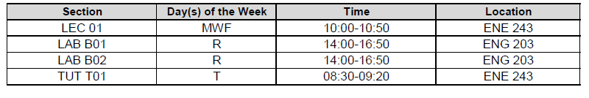
Timetable
The first lab will start on Feb 8 (B01) and Feb 15 (B02)

Slide 5
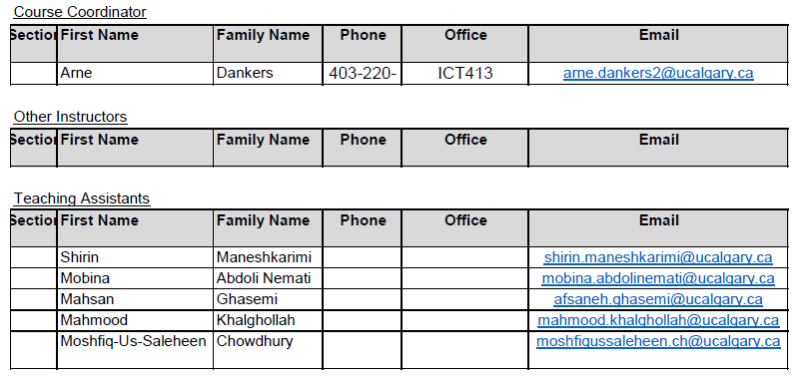
Course Instructors
Feel free to email me with questions/concerns/comments. I will try to respond in a reasonable time. Please put ENEL441 in the subject line of the email.
I am usually in my office. Feel free to drop by and ask questions in person.

Slide 6
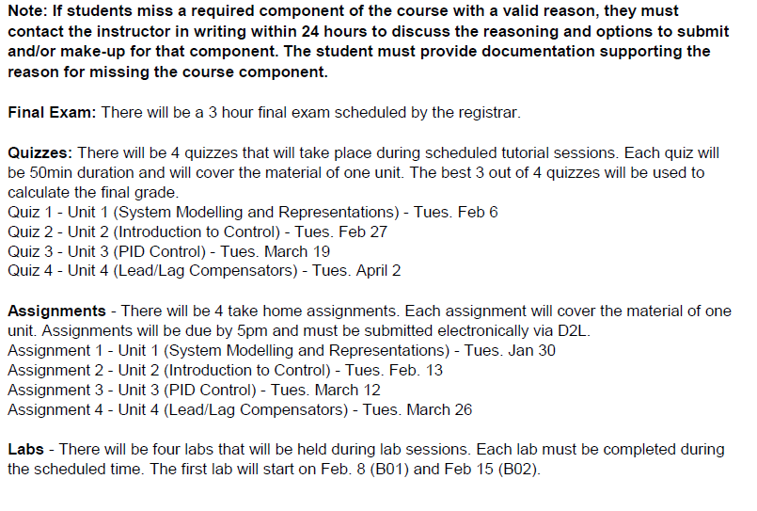
Assessments

Slide 7
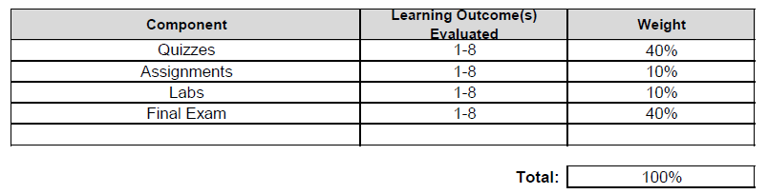
Final Grade Determination

Slide 8
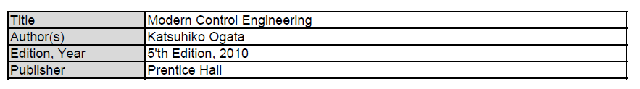
Textbook

Slide 9
Course Delivery - Lectures
Mix between lecturing and tutorial style
Technical content will be posted in videos on D2L. Watch the assigned videos before class.
In class activities will consist of
Pencil and paper exercises (please come prepared).
Python exercises (focused on exploration not coding). Please bring a laptop, sit together around someone with a laptop, or contact me to borrow a laptop.
Mentimeter question and answer sessions.

Slide 10
Course Delivery - Tutorials
Will focus on in class activities:
Pencil and paper exercises
Python exercises
Quizzes will be held during tutorials.

Slide 11
Course Delivery - Labs
4 labs
Simulation based (Python)
Completed and handed in during the scheduled sessions

Slide 12
Mentimeter
Objectives
Help you learn!
Help me see how it is going
Notes:
Private – no identifiers associated with answers, only final tally of answers can be accessed.
Not for grades

Slide 13
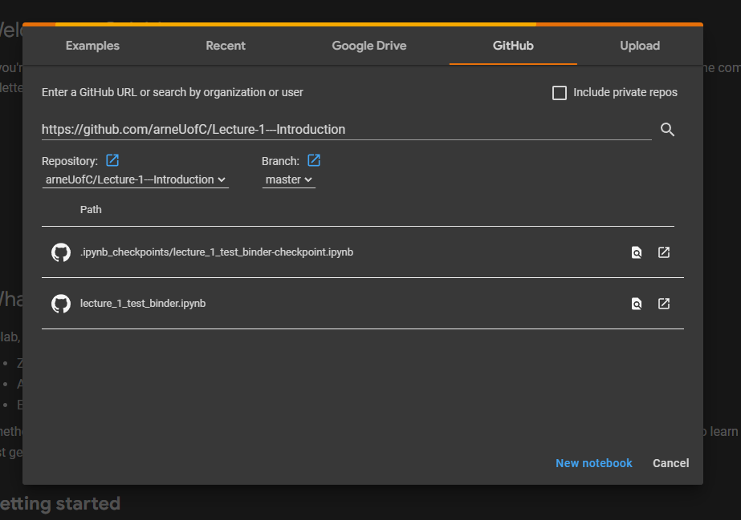
Python - Colab
Go to: https://colab.research.google.com/
Click on GitHub tab
In the GitHub URL enter https://github.com/arneUofC/Lecture-1---Introduction
You should see a .ipynb file called ‘lecture_1_test_bind.ipynb. Open it.

Slide 14
Python - Jupyter Notebooks
Instead of using Colab, you can install a local version of Jupyter Notebooks and run the code locally on your machine. The advantage of this method is that any changes you make to the code will be saved on your machine.
On D2L I have provided instructions on how to download and install Jupyter Notebooks.
I showed 3 different way:
Miniconda
Anaconda
Colab
There are many other ways. Feel free to choose your own favorite version if you prefer.

Slide 15
Introduction – Arne Dankers
My research is in data driven modelling aka system identification

Slide 16
What is System Identification, and How Can it Help You?
What is System Identification
System Identification is a class of machine learning (ML) that uses data to learn the differential equations that govern a system. For example, the equations governing a chemical reaction can be learned using data. The result is a model of a system.
Think of it as ML tailored to engineering systems.

Slide 17
How Can System Identification Help You?
What is System Identification Used For?
The resulting models can be used in order to design better controllers. Through better control the system can be made more energy efficient, or the purity of an end-product can be increased.
The resulting models can also be used to monitor the process for anomalies, changes or faults. The models can be used for predictive maintenance.

Slide 18
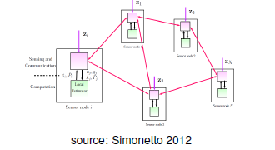
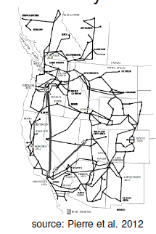
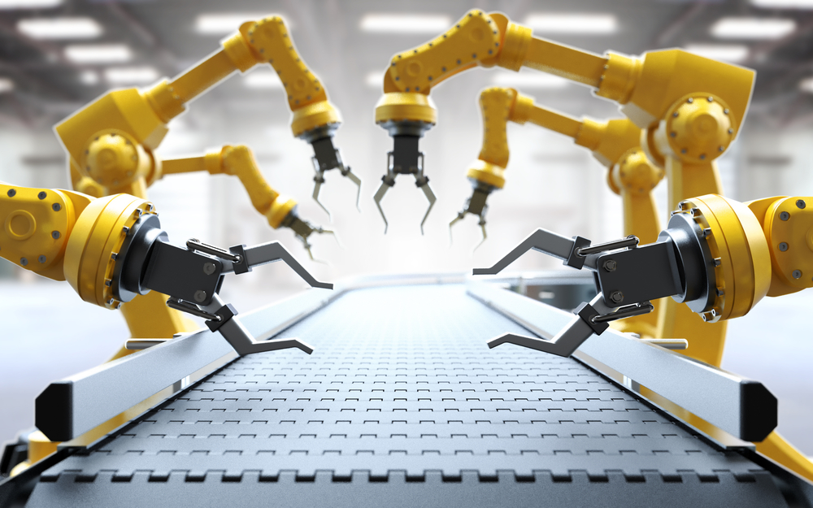
My research is in system identification of complex systems
Network System Identification
Distributed control
Power systems
Mechatronic Systems
Source: https://www.howtorobot.com/expert-insight/robotic-arms

Slide 19
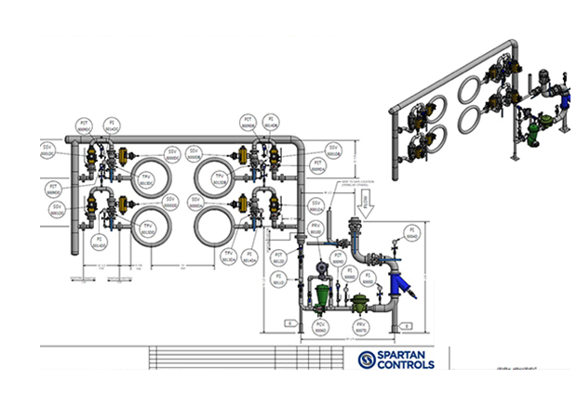
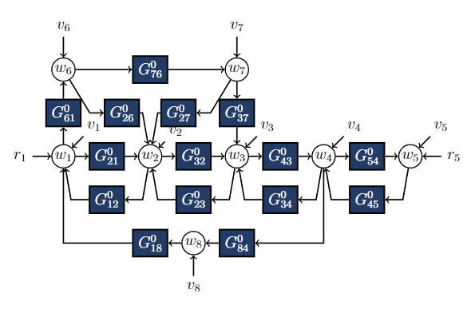
Unleash the Potential of Sensor Data!
Process
Model
Source: https://www.spartancontrols.com/solutions/combustion-management/boilers/water-tube-boilers/
Sensor data
Optimization
Monitoring

Slide 20
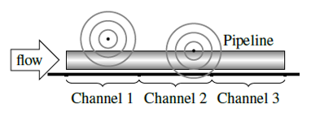
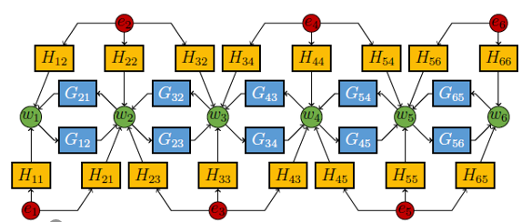

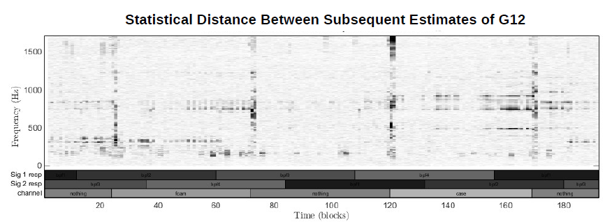
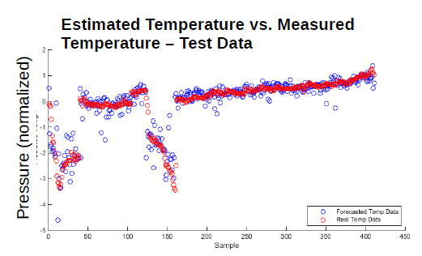
Acoustic Pipeline Monitoring
System
Model
Acoustic sensors placed along pipeline
Using sensor data, estimate frequency response of pipeline dynamics every minute
Estimated Pressure vs. Measured Pressure – Test Data
Monitor for statistically significant changes
Use ML to classify/diagnose estimated transfer function

Slide 21
Attabotics
https://www.google.com/search?q=attabotics&rlz=1C1GCEA_enCA1019CA1019&source=lnms&tbm=vid&sa=X&ved=2ahUKEwjnocj2la38AhX1JTQIHRJ_ByQQ_AUoA3oECAEQBQ&biw=1280&bih=552&dpr=1.5#fpstate=ive&vld=cid:ef69d7d2,vid:WLtEBaHkNJc

